Slide 1

UE20EC390B – Project Phase – 2
Review: 1
Project Title : Image Quality Enhancement in Visual Cryptography via Dithering, Noise Filtering, and Smoothing
Project Guide : Assistant Professor: Prahlad D
Project Team : RISHITHA OTRA. (PES2UG20EC070)
SIDDHARTH ST (PES2UG20EC087)
YASH SANTOSH DABKE (PES2UG20EC110)
MANOJ S (PES2UG20EC150)

Slide 2
Agenda
Introduction and Motivation
Problem Statement
Abstract and Scope
Literature Survey / Existing System
Suggestions from Phase 1 Reviews
Requirements Specification
Design Approach
Design Constraints, Assumptions & Dependencies
Proposed System / Approach
Design Description
Project Progress
Results and Analysis
Publication Status
References

Slide 3
Introduction and Motivation
a.) Adaptive Filters: To enhance image quality, the project incorporates adaptive filtering techniques. These filters are designed to reduce noise and correct distortions that may occur during the encryption process. By doing so, the shares or encrypted images maintain high visual quality.
b.) Security (AES Encryption): The project employs the Advanced Encryption Standard (AES) encryption algorithm to ensure robust security. AES is well-established and widely recognized for its strength in protecting confidential information. It guarantees that unauthorized users cannot access or decipher the secret information.
c.) Efficiency: The project leverages color visual cryptography, a technique that enhances efficiency in transmitting secret information. Unlike traditional visual cryptography that operates in black and white, color visual cryptography allows for the simultaneous transmission of multiple secret images within a single share, making the process more efficient and versatile.
d.) Novelty: This technique is a relatively new concept that combines several different technologies, making it an exciting area of research for those interested in cryptography, computer vision, and image processing.

Slide 4
Problem Statement
Image Quality Enhancement in Visual Cryptography via Dithering, Noise Filtering, and Smoothing

Slide 5
Abstract and Scope
The scope of this project encompasses the development and integration of custom algorithms for dithering, noise filtering, and smoothing techniques tailored to the domain of Visual Cryptography.
It involves preprocessing the original secret image to enhance its visual quality before encryption, applying these techniques to the generated shares while preserving their security, and evaluating the share quality through established metrics.
Experimental validation and comprehensive documentation will be conducted, with an eye towards potential future research and applications.
Ultimately, this project seeks to bridge the gap between image quality enhancement and secure information sharing, making it a multidisciplinary endeavor of significance in the fields of image processing and cryptography.

Slide 6
Updated Literature Survey/Existing System
1.) Half-Tone Visual Cryptography Scheme For RGB Color Images D R Somwanshi1∗, Vikas T Humbe2,2022: This research study presents a new and optimal scheme for the visual-cryptography which is centered on RGB color images. Jarvis halftoning is applied on each decomposed color channel that is used in share generation. A special code matrix is defined for the generation of color shares and the optimal reconstruction of the original image. The method is tested with color images of different sizes, no specific dataset is required. Pixel expansion, The Aspect Ratio, and Contrast of the method is compared with
the existing method, and found more enhanced result.
2.) Color Image Cryptography Scheme Based on Visual Cryptography Gopi Krishnan S I and Loganathan D2 : The proposed scheme uses the YCbCr color model and a visual cryptography approach for encryption and decryption. It starts by generating a key binary image with the same size as the secret image. The secret image is split into three monochrome images (luminance, chrominance blue, and chrominance red), and half-toning is applied to convert them into binary images. These binary images are then XORed with separate share-like images to create three additional random binary images. These are combined into a single half-toned color image called "share-2."

Slide 7
Suggestions from Phase 1 Reviews
In the recent reviews, we were asked to carefully assess the quality parameters of the image and provide a detailed discussion on this aspect. Furthermore, we were instructed to compare and contrast the quality of the original image with that of your improved image.

Slide 8
Requirements Specification
Functional requirements: These are the specific functions and features that the system or software should provide. For this project, functional requirements could include color visual cryptography, AES encryption, adaptive filtering, and image quality enhancement.
Non-functional requirements: These are the requirements that define the characteristics of the system or software, such as reliability, security, usability, performance, and maintainability. For this project, non-functional requirements could include high security of the encrypted image, user-friendly interface, and fast processing time.
Hardware and software requirements: These are the specific hardware and software requirements necessary for the system or software to run properly. For this project, hardware requirements could include a high-performance computer with a powerful graphics card, while software requirements could include the use of programming languages such as Python or MATLAB and image processing libraries.

Slide 9
TOOLS TO BE USED IN THIS PROJECT :
We will mainly be implementing in python as it is a popular language for image processing and cryptography, and has many libraries and frameworks that can be used for this project. Some of the libraries to be used in this project are :
1.) Image processing libraries : MATLAB, as it is a widely used open-source library for image and video processing, and can be used for tasks such as noise reduction, color space conversion, and image segmentation
2.) Cryptography libraries : PyCryptodome, as it provides a wide range of cryptographic algorithms, including the Advanced Encryption Standard (AES), which can be used for encrypting the shares.

Slide 10
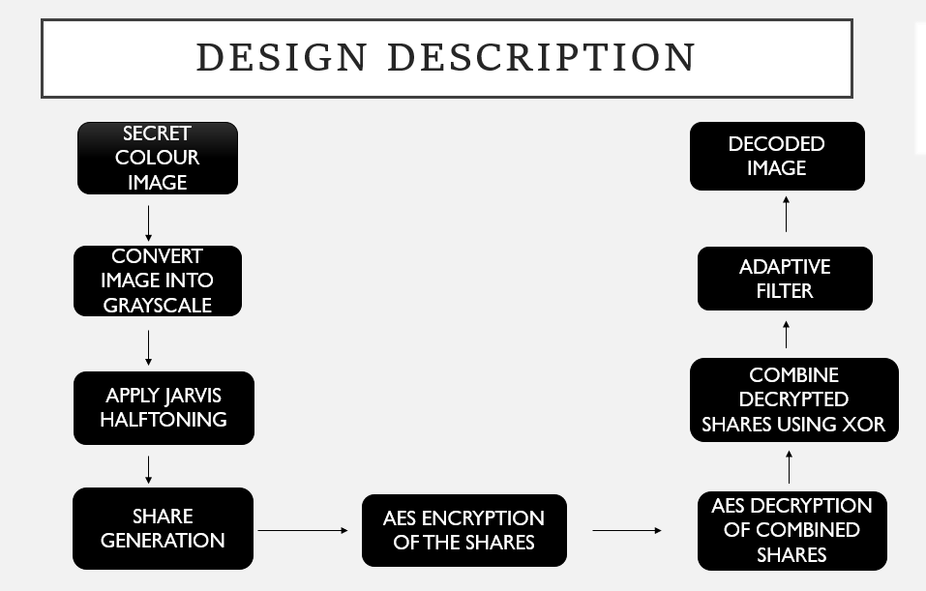
RECALL

Slide 11
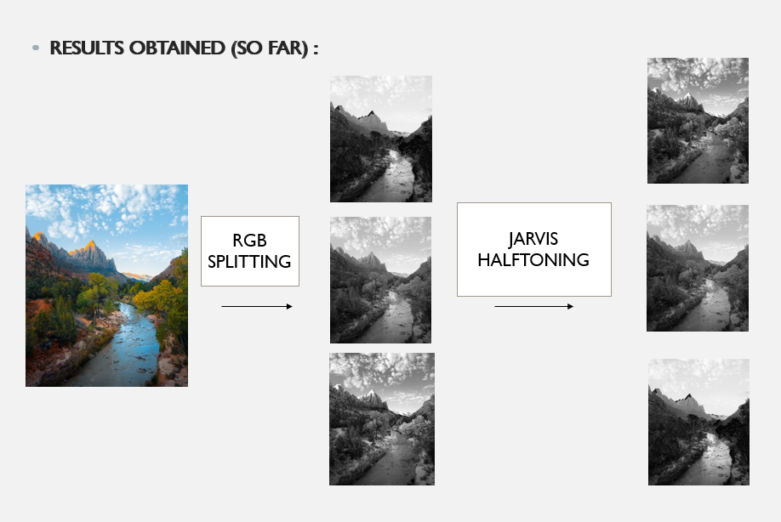
RECALL

Slide 12
RECALL
Previously done in ESA – PHASE 1:
1.) Color image conversion to grayscale: The system first converts the input color image to grayscale, as visual cryptography is generally performed on binary images. The grayscale image is then divided into two shares using a color visual cryptography technique, where each pixel in the original image is represented by a set of sub-pixels in each share.
2.) Jarvis Halftoning: The filtered shares are passed through the halftoning process. This process helps to enhance the contrast of the image and create a more visually appealing output. The final image is a combination of the shares that have been overlapped, filtered and enhanced.
3.) AES encryption : is applied to each share to further enhance the security of the system. AES encryption is a symmetric-key encryption algorithm that uses a key to encrypt and decrypt data. The key used for encryption is kept secret and shared only between the parties involved in the communication. The AES algorithm is a widely used encryption technique that provides robust security for confidential data.
4.) Adaptive filtering : is applied to each share to enhance the image quality and remove any noise that may have been introduced during the encryption process. Adaptive filtering is a type of image filtering that adjusts the filter parameters based on the local characteristics of the image. This technique is particularly effective in removing noise from images without blurring important details.

Slide 13
RECALL
The output of the system is two encrypted shares of the original color image, with enhanced security and improved image quality. These shares can be distributed to the intended recipients who can then use the color visual cryptography technique to reconstruct the original image.
Overall, the proposed system offers an effective solution for securing and improving the quality of color images using a combination of visual cryptography, AES encryption, and adaptive filtering techniques.

Slide 14
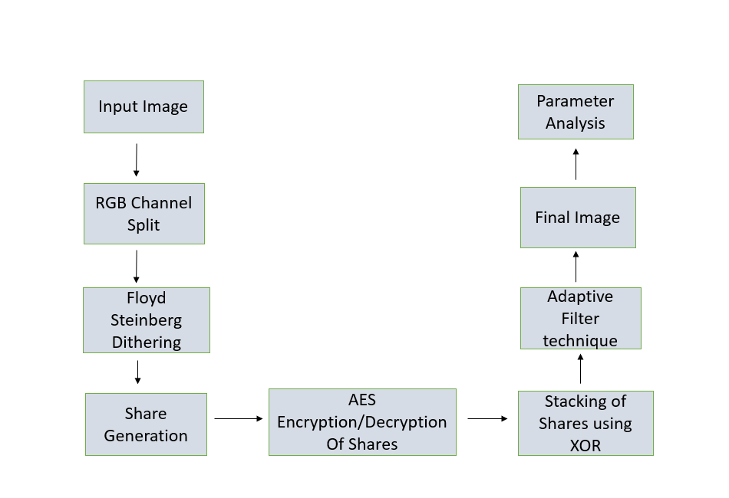
Updated Design Details

Slide 15
Updated Design Details
This project focuses on the enhancement of image quality in the context of visual cryptography, a technique for securing and sharing sensitive images.
The process involves several key steps: starting with an input image, splitting it into its Red, Green, and Blue (RGB) channels, and then applying the Floyd-Steinberg dithering technique to reduce colors and create binary representations of each channel.
These binary images are further transformed into shares through methods like reverse XORing. To ensure security, AES encryption is applied to the shares.
The recipient combines these shares through XORing to reconstruct the original image, which may still lack optimal quality.
To address this, adaptive filters, including local noise filters, Gaussian filters, and Laplacian filters, are used to enhance the combined image's quality.
Finally, the project assesses the results using various image quality metrics like Mean Squared Error (MSE), Peak Signal-to-Noise Ratio (PSNR), Mean Difference (MD), Normalized Absolute Error (NAE), and Structural Similarity Index (SSIM).
This comprehensive approach aims to improve the overall quality and security of visual cryptography-based image sharing.

Slide 16
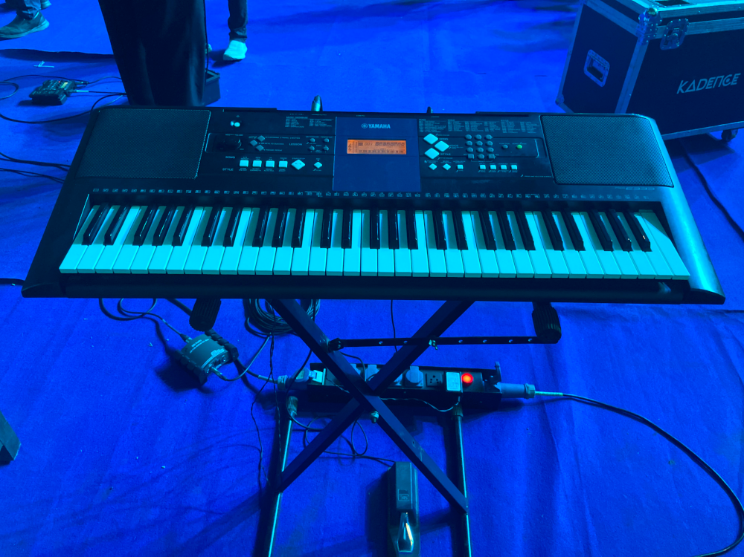
Updated Design Details
1.) Sending Input Image - The project begins with an input image, which is typically a sensitive or confidential image that needs to be securely shared.
Original Input Image

Slide 17
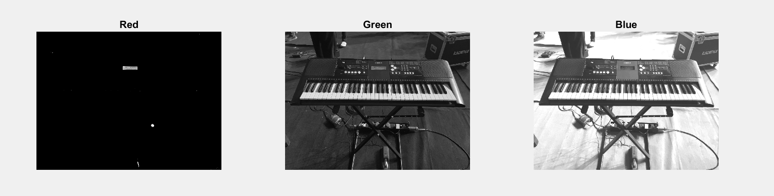
Updated Design Details
2.) Splitting Image into RGB Channel - The input image is split into its three primary color channels: Red, Green, and Blue (RGB). Separating the image into these channels allows you to process each color component independently, which can be beneficial for certain image processing operations.

Slide 18
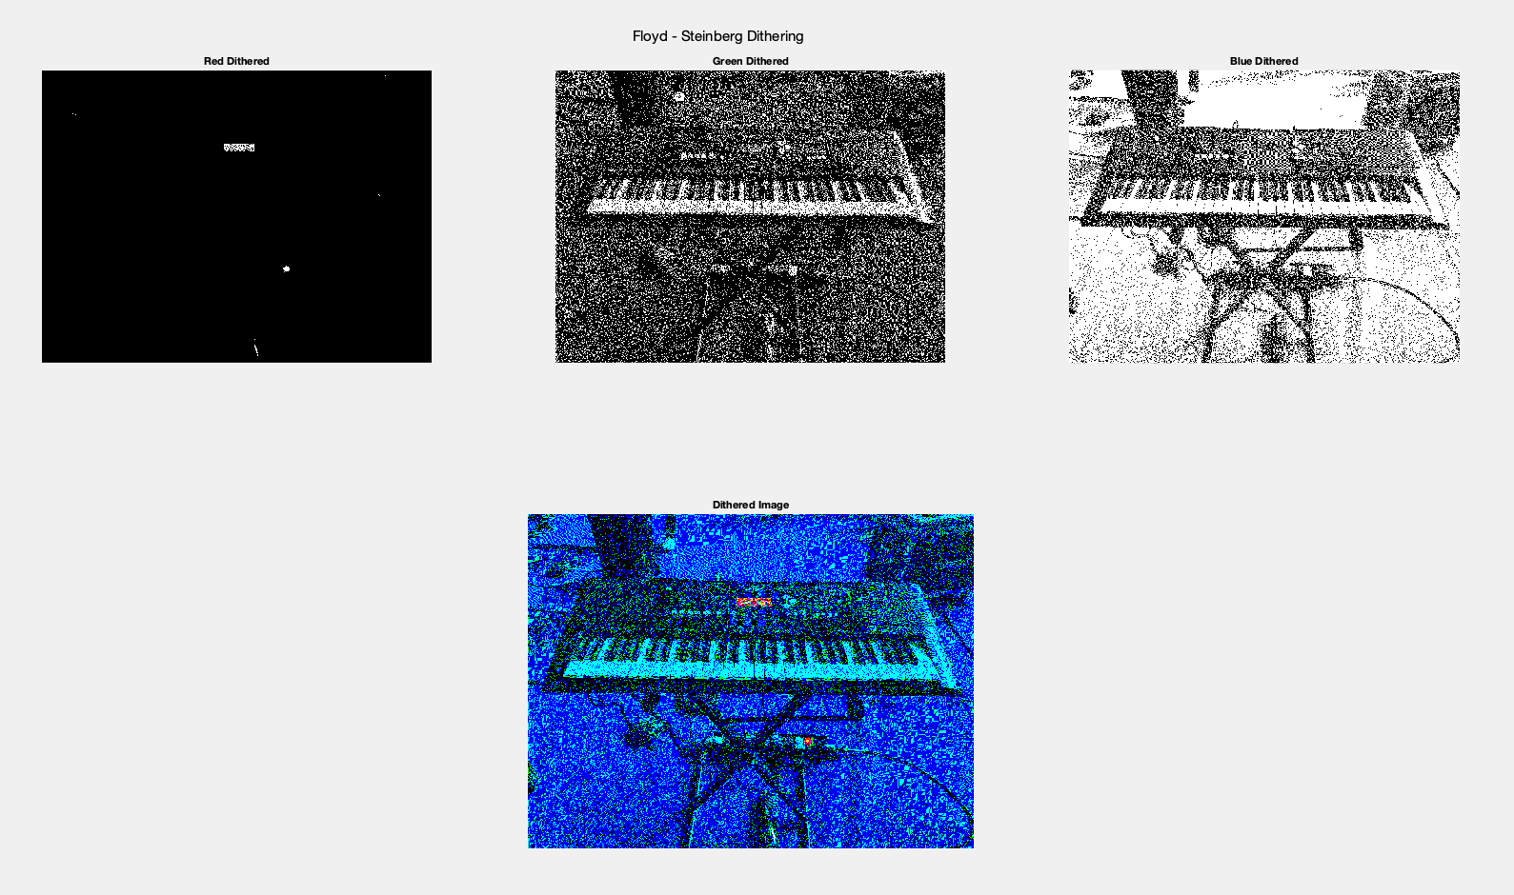
Updated Design Details
3.) Floyd-Steinberg Dithering Technique: Floyd-Steinberg dithering is a widely used technique in image processing to reduce the number of colors in an image, converting it into a binary or grayscale representation.
It works by diffusing quantization error from one pixel to its neighboring pixels during the conversion process. Each RGB channel is processed separately using this technique to create binary images.

Slide 19
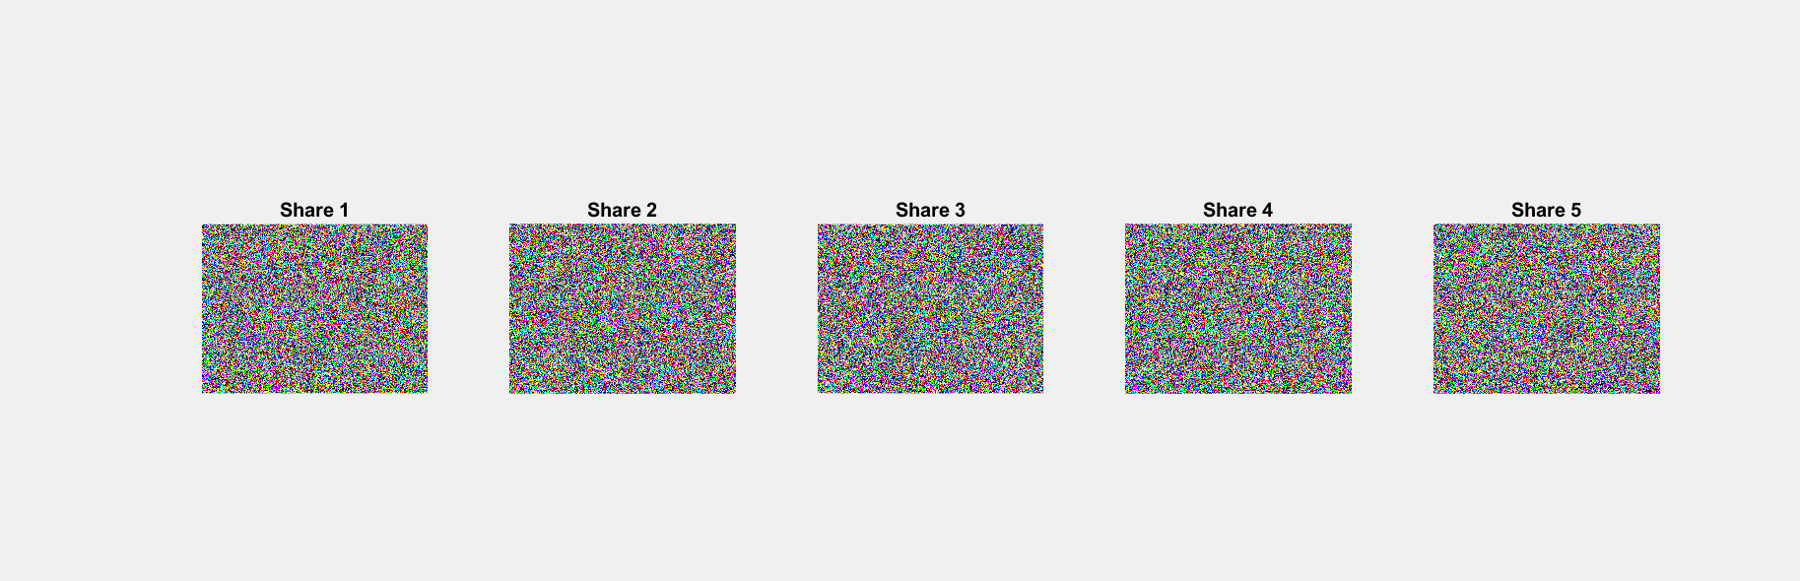
Updated Design Details
4.) Share Generation: The binary images produced in the previous step are transformed into shares.
In visual cryptography, shares are essentially encrypted versions of the original image.
Techniques like reverse XORing may be used to split each binary image into multiple shares. These shares are typically encrypted and distributed to different parties for secure storage or transmission.

Slide 20
Updated Design Details
5.) AES Encryption and Decryption:
Each share created in the previous step is encrypted using the Advanced Encryption Standard (AES).
AES is a symmetric encryption algorithm that ensures the confidentiality and security of the shares.
Encryption is necessary to protect the content of the shares from unauthorized access.

Slide 21
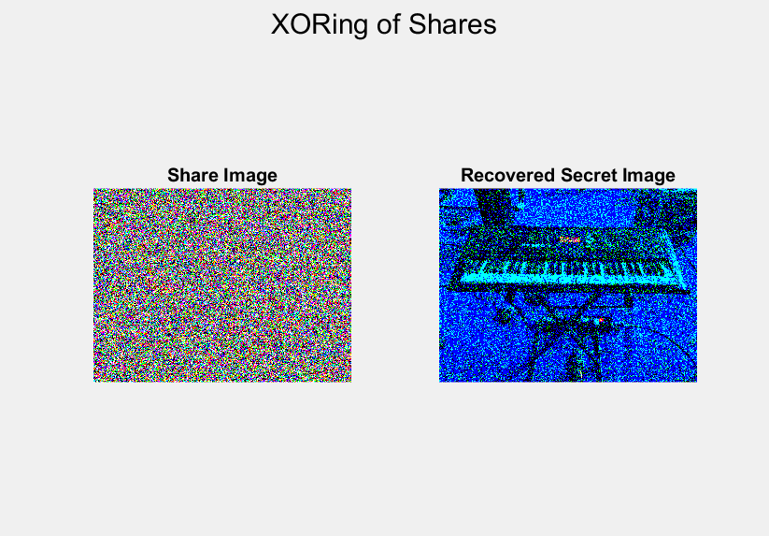
Updated Design Details
6.) Stacking of Shares Using XORing:
To reconstruct the original image, a recipient needs to stack the encrypted shares together using the XOR (exclusive OR) operation.
XORing the shares reveals the original image because the encryption process distributes information across the shares in such a way that combining them recreates the original data.
However, the combined image may still have quality issues due to the encryption and sharing process.

Slide 22
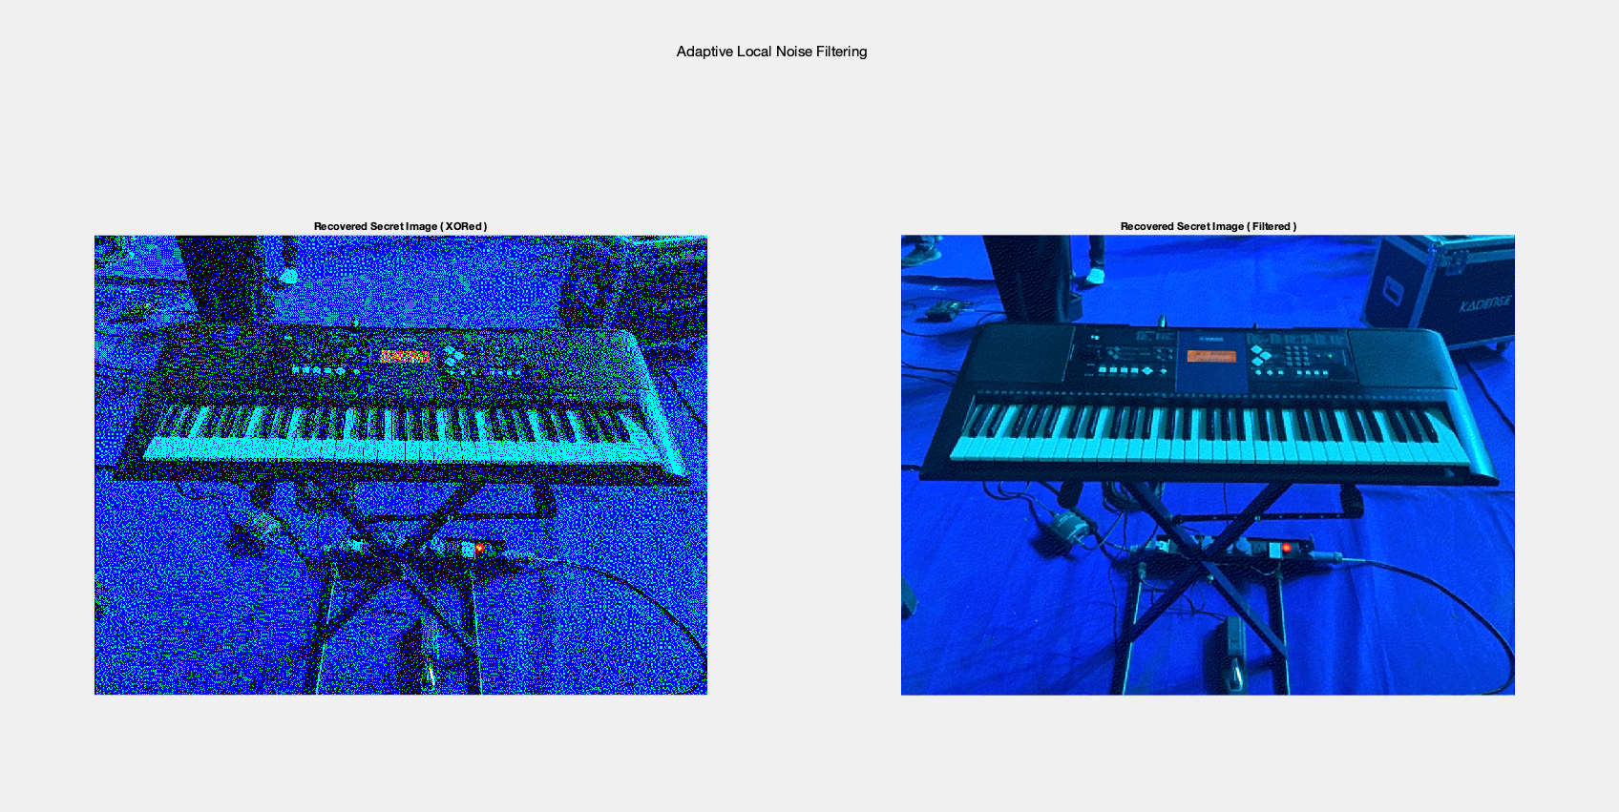
Updated Design Details
7. ) Using Adaptive Filters for Quality Improvement: Adaptive filters are applied to the combined image to enhance its visual quality.
These filters can include techniques such as local noise filters, Gaussian filters, and Laplacian filters.
Local noise filters remove unwanted noise, Gaussian filters can smooth the image, and Laplacian filters enhance edges and fine details.

Slide 23
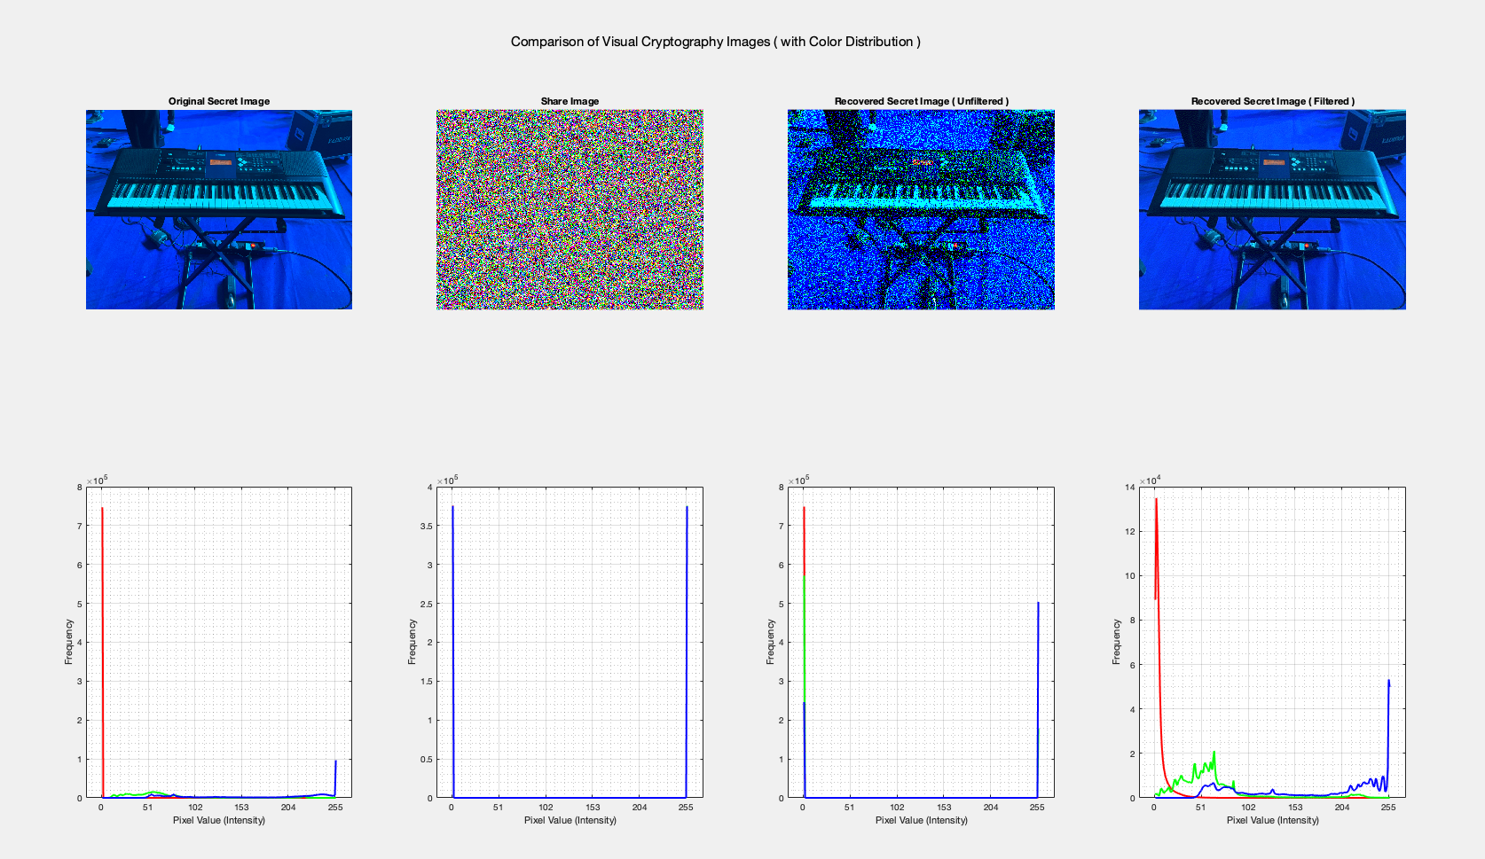
Updated Design Details
8.) Obtaining the Final Image: After applying adaptive filters, you obtain the final enhanced image.
This image should have improved quality compared to the combined shares, making it suitable for visualization and analysis.

Slide 24
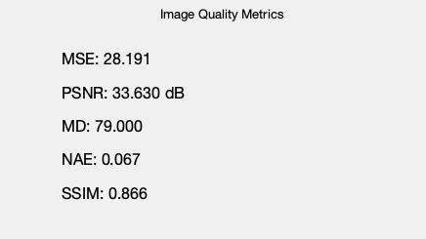
Updated Design Details
9.) Checking Parameters: To quantitatively assess the effectiveness of your image enhancement techniques, various image quality metrics are used.
These metrics include Mean Squared Error (MSE), Peak Signal-to-Noise Ratio (PSNR), Mean Difference (MD), Normalized Absolute Error (NAE), and Structural Similarity Index (SSIM).
These parameters help you measure the quality improvement achieved in the final enhanced image compared to the original input image.

Slide 25
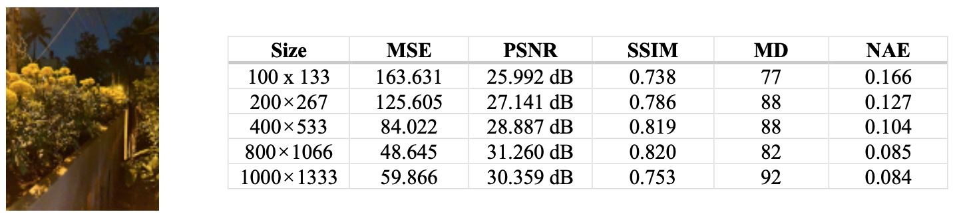
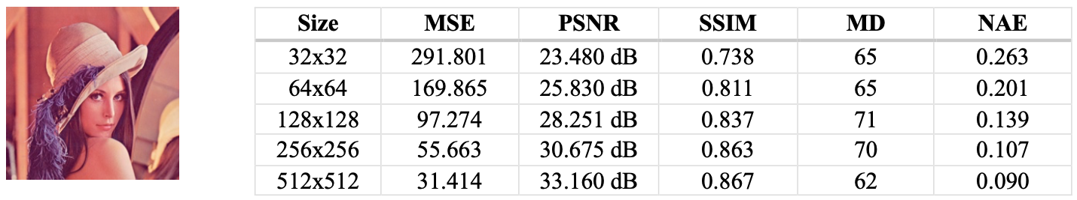
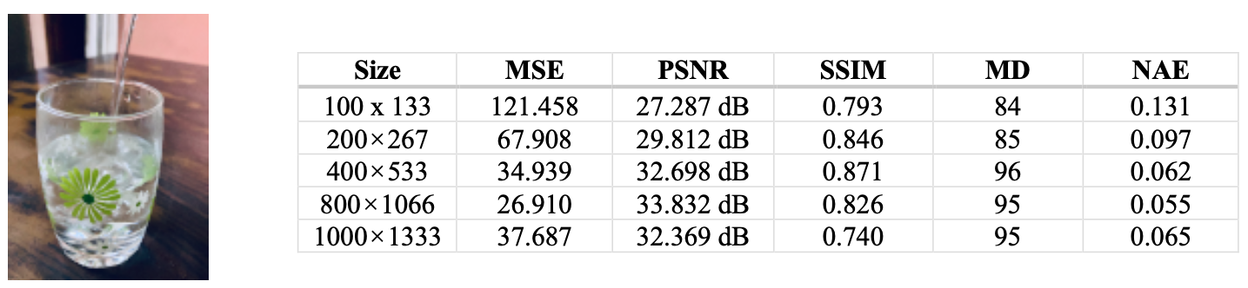
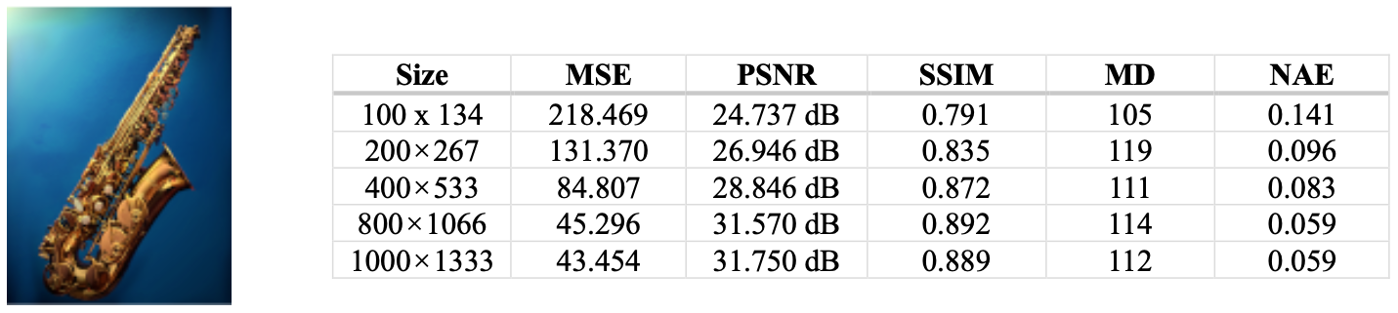
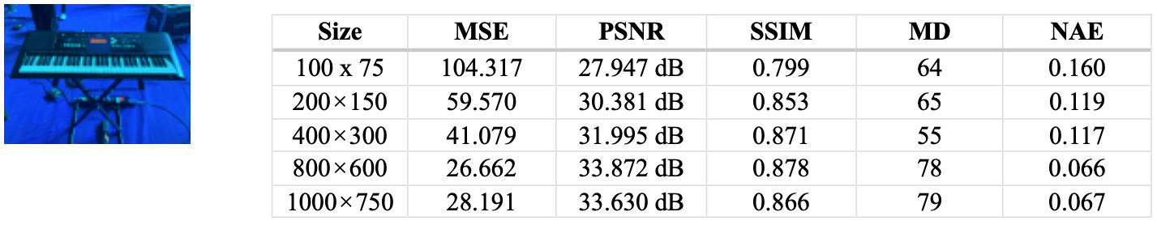
Results and Analysis
Image Quality Parameters Obtained for Different Sized Images

Slide 26
Individual Contribution

Slide 27
Publication status of your work
We’re in the process of planning the paper's structure and developing the approach for writing it. We'll begin drafting the paper soon.

Slide 28
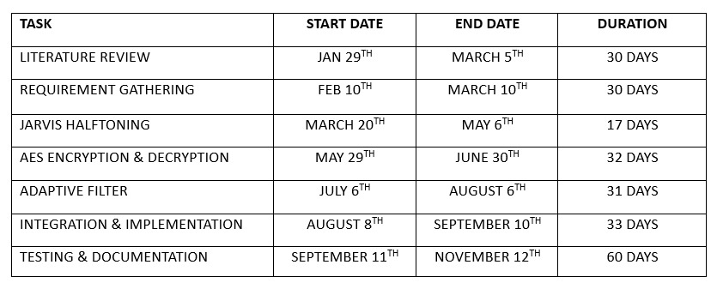
The discussed timeline in ESA phase 1

Slide 29
Conclusion
In conclusion, this project has explored the vital intersection of image quality enhancement and visual cryptography, aiming to address the challenges of securely sharing sensitive images while preserving their visual integrity.
Through a systematic approach, we have demonstrated the effectiveness of our proposed methods. The utilization of Floyd-Steinberg dithering for error diffusion and share generation, followed by AES encryption, provided a robust foundation for secure image sharing.
Furthermore, the application of adaptive filters, including local noise filters, Gaussian filters, and Laplacian filters, significantly improved the visual quality of the reconstructed images.
Our project contributes to the fields of image processing and cryptography by providing a practical solution for enhancing image quality while maintaining security.
The use of comprehensive image quality metrics, such as MSE, PSNR, MD, NAE, and SSIM, has allowed us to quantitatively assess the improvements achieved.
As a result, we believe that our work offers a valuable contribution to both the security and visual fidelity aspects of visual cryptography, with potential applications in secure image sharing across various domains.
Future work in this area could explore further optimization and the integration of more advanced encryption techniques to enhance security further.

Slide 30
References
Shah, S., & Singh, S. (2021). Enhanced Visual Cryptography Scheme for Secret Image Retrieval using Average Filter. International Journal of Advanced Science and Technology, 30(3), 1635-1643. https://doi.org/10.14257/ijast.2021.30.03.155
Abikoye Oluwakemi Christiana, Akande Noah Oluwatobi, Garuba Ayomide Victory, Ogundokun Roseline Oluwaseun. "A Secured One Time Password Authentication Technique using (3, 3) Visual Cryptography Scheme" , Journal of Physics: Conference Series, 2019
Q. Zhang and Q. Ding, "Digital Image Encryption Based on Advanced Encryption Standard (AES)," 2015 Fifth International Conference on Instrumentation and Measurement, Computer, Communication and Control (IMCCC), 2015, pp. 1218-1221, doi: 10.1109/IMCCC.2015.261
Pooja Kashyap, A. Renuka. "Visual Cryptography for colour images using multilevel thresholding",.2019 Third International Conference on Inventive Systems and Control (ICISC), 2019

Slide 31
Thank You

